Slide 1
MIRO
မိတ္ဆက္

Slide 2
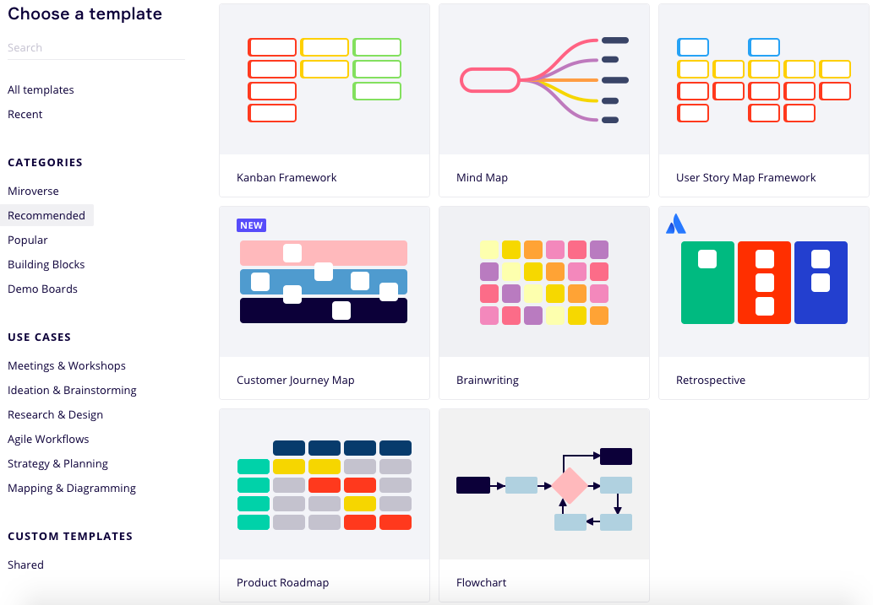

Slide 3
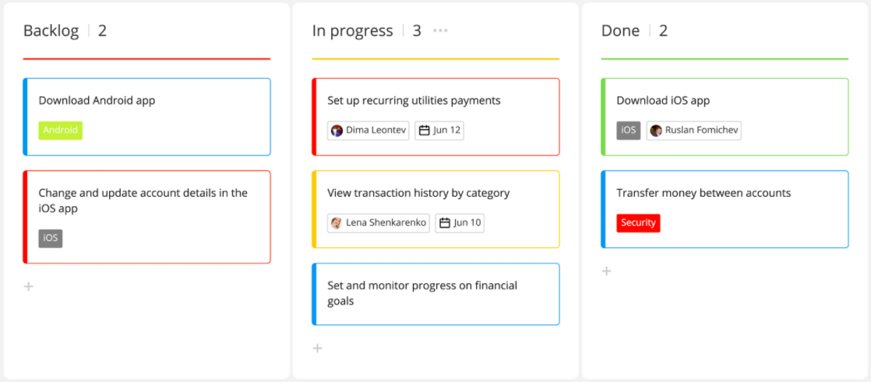
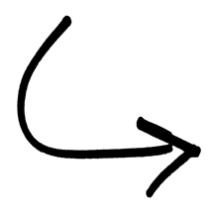
KANBAN FRAMEWORK

Slide 4
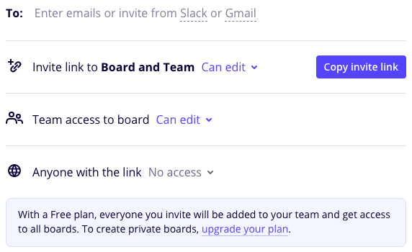
SHARE YOUR BOARD

Slide 5
TRELLO
မိတ္ဆက္

Slide 6
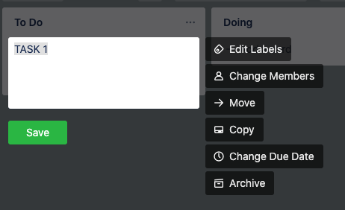
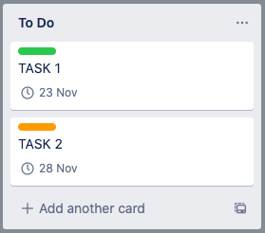
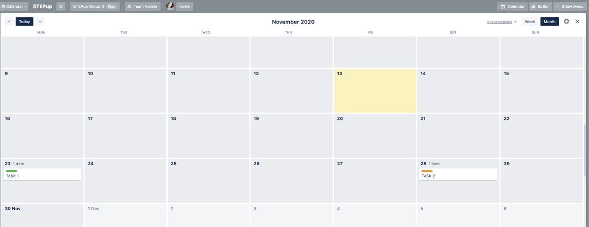

Slide 7
LEANSTACK
မိတ္ဆက္

Slide 8
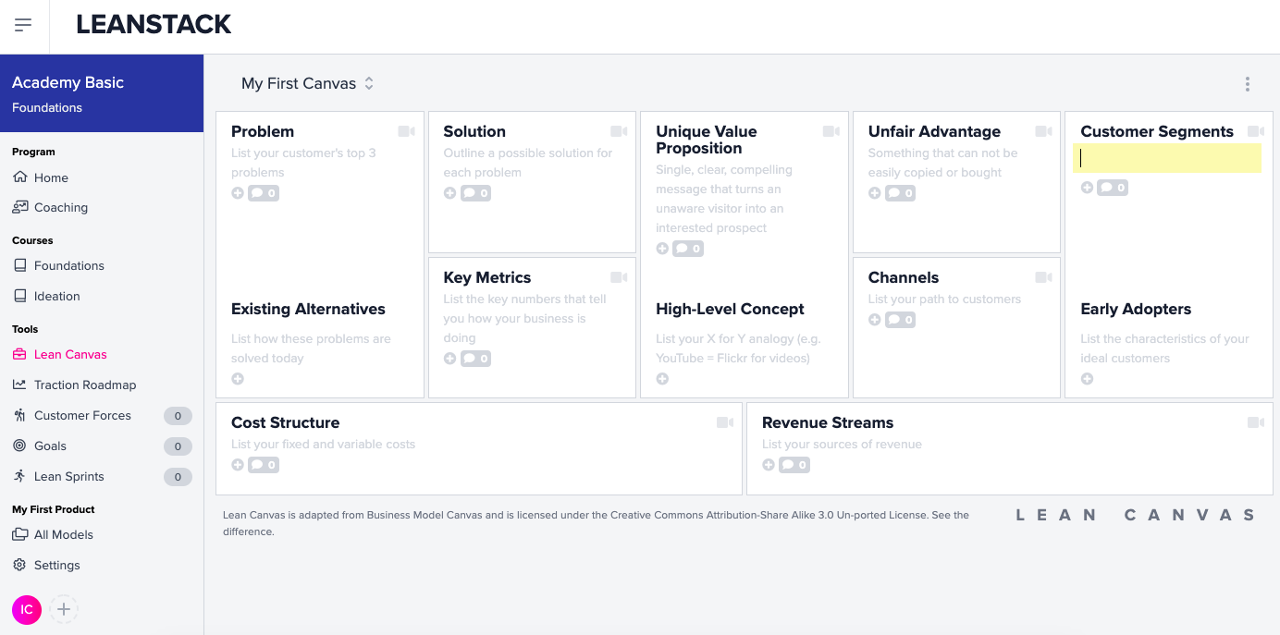
4
9
2
1
5
7
6
8
3

Slide 9
